Slide 1
INTERNAL MEMORY
Internal Memory- semiconductor main memory, advanced DRAM organization. External Memory, Hard Disk organization. RAID- level 1 to level 6.

Slide 2
Introduction to Internal Memory
Internal memory is also called primary memory or main memory.
It stores data and instructions currently being used by the CPU.
Located close to or inside the processor, providing high-speed access.
Acts as a bridge between CPU and secondary storage (HDD, SSD).
It includes high-speed storage components such as registers, cache memory, and main memory (RAM), and some forms of ROM used to store system-level instructions.

Slide 3
Types of Internal Memory
Internal memory is generally classified into:
CPU Registers
Cache Memory (L1, L2, L3)
Main Memory (RAM)
Read Only Memory (ROM)

Slide 4
Semiconductor Main Memory
Semiconductor memory is the primary storage used in computers, made using semiconductor (silicon-based) technology.
It includes RAM, ROM, and several special-purpose memory types.
Characteristics of Semiconductor Memory
Volatile or non-volatile:
RAM → volatile
ROM, Flash → non-volatile
Fast access time compared to magnetic/optical storage.
Random access: All locations accessible in equal time.
Low power consumption (especially static RAM).
Integrated on chips, allowing compact, dense memory modules.
Used as primary memory in the memory hierarchy.

Slide 5
Types of Semiconductor Memory
There are two types of semi conductor memory
Random Access Memory(RAM)
Read-Only Memory(ROM)
Random Access Memory(RAM):
It permits information to be gotten to in any request, making it appropriate for brief capacity.
Type: Unpredictable - information evaporates without power.
Function: stores data for active applications on a temporary basis.
Speed: lightning-fast access in a flash.
Capacity: Normally more modest than ROM.
Applications: Running projects, open documents, program tabs.

Slide 6
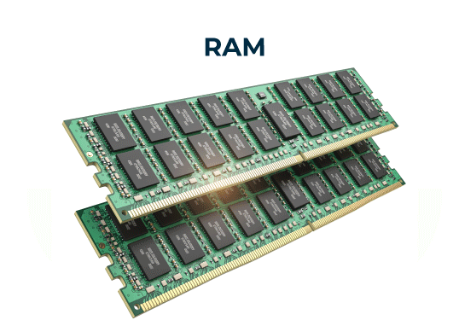

Slide 7
Read Only Memory(ROM)
Information is for all time put away and can't be changed during typical activity.
It is utilized for putting away firmware and other basic information.
Type: Non-unstable - information perseveres even without power.
Function: provides permanent storage for essential functions.
Speed: More slow than Smash, as information recovery isn't as incessant.
Capacity: Variable based on device complexity.
Applications: Firmware, the operating system, and device drivers.

Slide 8

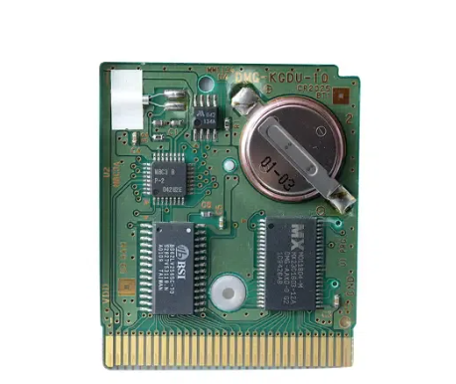

Slide 9
Working of Semiconductor Memory
Semiconductor memory stores information utilizing minuscule circuits called memory cells.
Every memory cell is comprised of semiconductors and capacitors.
The semiconductors go about as switches, controlling the progression of power to the capacitor.
The capacitor stores the electrical charge, addressing a paired "0" or "1".

Slide 10
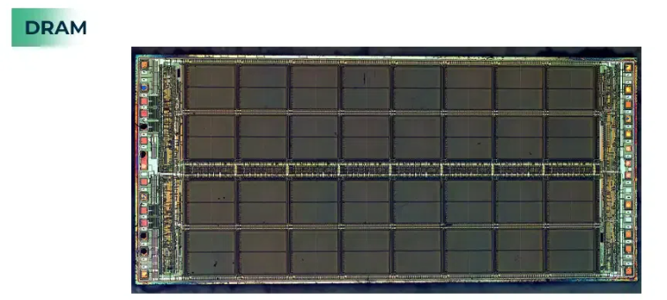
Examples of Semiconductor Memory
DRAM: In DRAM, the capacitor stores the information bit as a charge. However, the memory cell needs to be refreshed on a regular basis to prevent data loss as this charge slowly leaks over time. Reviving includes perusing the information from the cell, enhancing it, and afterward composing it back to the cell.
Dynamic Random Access Memory(DRAM):It is commonly used in computers for temporary data storage.

Slide 11
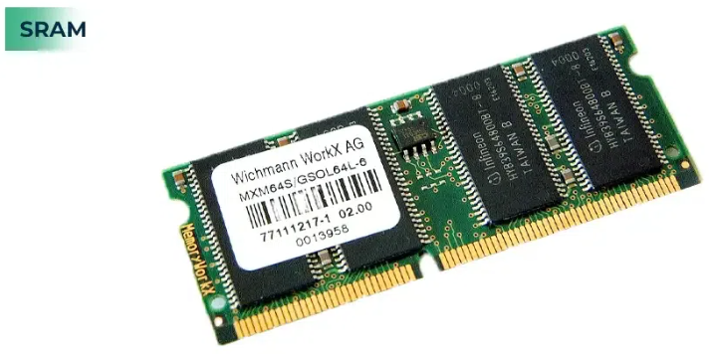
Static Random Access Memory(SRAM):Used for excessive-velocity information storage, which include caches in processors.
SRAM: In SRAM, the information bit is put away as a lock circuit shaped by two semiconductors.
This circuit doesn't need to be refreshed and can keep the integrity of the data as long as there is power.

Slide 12
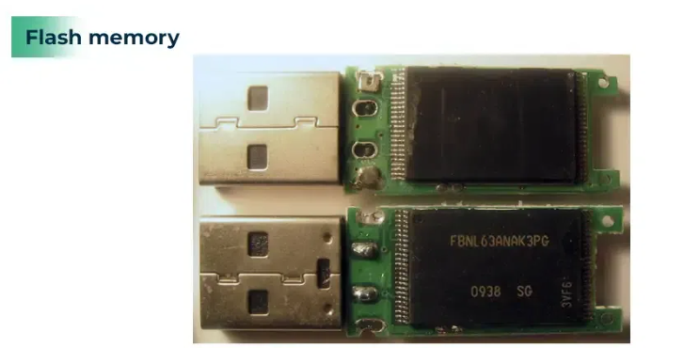
Flash Memory: Used for permanent garage of statistics, which includes in USB drives and strong-country drives (SSDs).
Streak memory utilizes an alternate innovation called drifting entryway semiconductors. The memory can be erased and reprogrammed electrically thanks to these transistors' additional gate, which can be used to trap or release electrons.

Slide 13
Advantages of Semiconductor Memory
High Speed: Fast data retrieval from semiconductor memory enables responsive performance and smooth operation. Applications like gaming, real-time video, and online transaction all depend on this.
Low power consumption: Compared to other types of memory, such as magnetic storage, semiconductor memory is very energy efficient. This is important for laptops and mobile devices, as it extends battery life.
High storage density: Semiconductor memory can pack an enormous measure of information into a minuscule space. Because of this, it is ideal for high-performance computing systems and portable devices like smartphones and tablets where space is at a premium.
Scalability: Semiconductor memory innovation can be effortlessly scaled to satisfy the rising needs of registering. This indicates that the capacity of semiconductor memory chips will also increase in tandem with our demand for data storage.
Non-volatile(except for RAM): Non-volatile semiconductor memory, such as read-only memory (ROM) and flash memory, stores data even when the power is turned off. Because of this, they are excellent for storing long-term data like operating systems and firmware.

Slide 14
Disadvantages of Semiconductor Memory
Volatile(for RAM): When the power is turned off, data stored in traditional RAM are lost. This can be risky on the off chance that you are chipping away at something significant and the power goes out of the blue.
Can be much expensive: When compared to other types of storage, such as hard disk drives, high-performance or large-capacity semiconductor memory can be expensive.
Limited lifespan(for Flash memory): Flash memory has a set number of compose cycles before it breaks down. As a result, flash memory devices will eventually require replacement.
Security issues: Semiconductor memory can be helpless against information breaks and hacking. This is due to the fact that the data is stored electronically and can be accessed in the event that the device is hacked.
Effect on the Environment: The process of manufacturing semiconductor memory chips can be resource-intensive and harmful to the environment. However, efforts are being made to develop production methods that are more environmentally friendly.

Slide 15
Applications of Semiconductor Memory
Semiconductor memory is used in a wide variety of applications, including:
Digital Cameras: Used for storing photographs and recordings.
Smartphones: Used for storing applications, music, photos and other valuable information.
Computers: Used for storing program instruction and working data.
USB drivers: Used for storing potable data storage.
Solid state drive(SSD): Used for high-performance storage in computers.
MP3 Player: Used to store music.

Slide 16
Advanced DRAM organization
The traditional DRAM is constrained both by its internal architecture and by its interface to processor's memory bus. The new enhancements (most common) on DRAM architecture are:
Synchronous DRAM (SDRAM)
Rambus DRAM (RDRAM)
Double Data Rate DRAM (DDR DRAM)
Cache DRAM (CDRAM)

Slide 17
1. Synchronous DRAM (SDRAM)
Exchange data with the processor synchronized to an external clock signal and running at the full speed of the processor/memory bus without imposing wait states.
One word of data is transmitted per clock cycle (single data rate).[All control, address, & data signals are only valid (and latched) on a clock edge.]
Typical clock frequencies are 100 and 133 MHz.
SDRAM has multiple-bank internal architecture that improves opportunities for on-chip parallelism. Generally it uses dual data banks internally. It starts access in one bank then next, and then receives data from first then second.
SDRAM performs best when it is transferring large blocks of data serially, such as for applications like word processing, spreadsheets and multimedia.

Slide 18
2. Rambus DRAM (RDRAM)
RDRAM chips are vertical packages with all pins on one side.
The chip exchanges data with the processor over 28 wires no more than 12 cm long. The bus can address upto 320 RDRAM chips.
Entire data blocks are access and transferred out on a high-speed bus-like interface (500 Mbps to 1.6 Gbps).
It has tricky system level design where the bus itself defines impedance, clocking and signaling very precisely.
More expensive memory chips.
Concurrent RDRAMs have been used in video games, while Direct RDRAMs have been used in computers.

Slide 19
3. Double Data Rate DRAM (DDR DRAM)
Uses both rising (positive edge) and falling (negative) edge of clock for data transfer.
That is DDR SDRAM can send data twice per clock cycle - once on the rising edge of the clock pulse and once on the falling edge.
There has been improvement in DDR DRAM technology.
The later generations (DDR2 and DDR3) increases the data rate by increasing the operational frequency of the RAM chip and by increasing the pre fetch buffer from 2 bits to 4 bits per chip.
DDR can transfer data at a clock rate in the range of 200MHz to 600 MHz, DDR2 can transfer in the range of 400MHz to 1066MHz and DDR3 can transfer in the range of 800MHz to 1600 MHz

Slide 20
4. Cache DRAM (CDRAM)
Integrates a small SRAM cache onto a generic DRAM chip.
The SRAM on CDRAM can be used in two ways
It can be used as true cache.
It can be used as buffer to support the serial access of a block of data.
This architecture achieves concurrent operation of DRAM and SRAM synchronized with an external clock.
Separate control and address input terminals of the two portions enable independent control of the DRAM and SRAM, thus the system achieves continuous and concurrent operation of DRAM and SRAM.
CDRAM can handle CPU, direct memory access (DMA) and video refresh at the same time by utilizing a high-speed video interface.
CDRAM can replace cache and main memory, and it is has already been proven that a CDRAM based system has a 10 to 50 percent performance advantage over a 256kbyte cache based system.

Slide 21
External memory
Secondary memory is also termed external memory and refers to the various storage media on which a computer can store data and programs
It is a non-volatile memory and used to store a large amount of data or information.
The data or information stored in secondary memory is permanent, and it is slower than primary memory.
A CPU cannot access secondary memory directly. The data/information from the auxiliary memory is first transferred to the main memory, and then the CPU can access it.

Slide 22
Characteristics of Secondary Memory
It is a slow memory but reusable.
It is a reliable and non-volatile memory.
It is cheaper than primary memory.
The storage capacity of secondary memory is large.
A computer system can run without secondary memory.
In secondary memory, data is stored permanently even when the power is off.

Slide 23
Types of Secondary Memory
1. Magnetic Tapes:
Magnetic tape is a long, narrow strip of plastic film with a thin, magnetic coating on it that is used for magnetic recording.
Bits are recorded on tape as magnetic patches called RECORDS that run along many tracks.
Typically, 7 or 9 bits are recorded concurrently.
Each track has one read/write head, which allows data to be recorded and read as a sequence of characters.
It can be stopped, started moving forward or backwards or rewound.

Slide 24
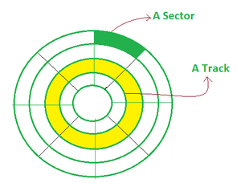
2. Magnetic Disks:
A magnetic disk is a circular metal or a plastic plate and these plates are coated with magnetic material.
The disc is used on both sides.
Bits are stored in magnetized surfaces in locations called tracks that run in concentric rings.
Sectors are typically used to break tracks into pieces.
Hard discs are discs that are permanently attached and cannot be removed by a single user.

Slide 25
3. Optical Disks:
It's a laser-based storage medium that can be written to and read. It is reasonably priced and has a long lifespan. The optical disc can be taken out of the computer by occasional users.
Types of Optical Disks
It's called a compact disk. Only read from memory.
Information is written to the disc by using a controlled laser beam to burn pits on the disc surface.
It has a highly reflecting surface, which is usually aluminium.
The diameter of the disc is 5.25 inches.
16000 tracks per inch is the track density.
The capacity of a CD-ROM is 600 MB, with each sector storing 2048 bytes of data.
The data transfer rate is about 4800KB/sec. & the new access time is around 80 milliseconds.

Slide 26
WORM-(WRITE ONCE READ MANY)
A user can only write data once.
The information is written on the disc using a laser beam.
It is possible to read the written data as many times as desired.
They keep lasting records of information but access time is high.
It is possible to rewrite updated or new data to another part of the disc.
Data that has already been written cannot be changed.
Usual size - 5.25 inch or 3.5 inch diameter.
The usual capacity of a 5.25-inch disk is 650 MB,5.2GB etc.

Slide 27
DVDs
The term "DVD" stands for "Digital Versatile/Video Disc," and there are two sorts of DVDs:
DVDR (writable)
DVDRW (Re-Writable)
DVD-ROMS (Digital Versatile Discs): These are read-only memory (ROM) discs that can be used in a variety of ways. When compared to CD-ROMs, they can store a lot more data. It has a thick polycarbonate plastic layer that serves as a foundation for the other layers. It's an optical memory that can read and write data.
DVD-R: DVD-R is a writable optical disc that can be used just once. It's a DVD that can be recorded. It's a lot like WORM. DVD-ROMs have capacities ranging from 4.7 to 17 GB. The capacity of 3.5 inch disk is 1.3 GB.

Slide 28
Difference between Primary Memory and Secondary Memory:
Primary Memory | Secondary Memory
Primary memory is directly accessed by the Central Processing Unit(CPU). | Secondary memory is not accessed directly by the Central Processing Unit(CPU). Instead, data accessed from a secondary memory is first loaded into Random Access Memory(RAM) and is then sent to the Processing Unit.
RAM provides a much faster-accessing speed to data than secondary memory. By loading software programs and required files into primary memory(RAM), computers can process data much more quickly. | Secondary Memory is slower in data accessing. Typically primary memory is six times faster than secondary memory.
Primary memory, i.e. Random Access Memory(RAM) is volatile and gets completely erased when a computer is shut down. | Secondary memory provides a feature of being non-volatile, which means it can hold on to its data with or without electrical power supply.

Slide 29
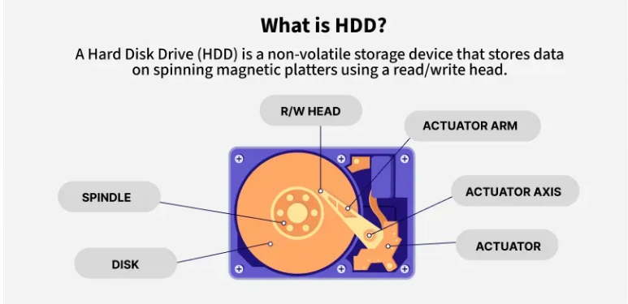
Hard Disk organization

Slide 30
Hard Disk Drive Components and Form Factors
HDD has the Aluminium components
Platters: Magnetic platters are disk-like in shape and used to store data. Typically, they are made from glass or aluminium and laid down on a spindle where layers of such disks are kept one after the other.
Spindle: The spindle maintains the platters in place and rotates them as required. The Revolution Per Minute(RPM) rating controls how fast data can be written to and read from the hard drive.
Actuator Arm: The actuator, also known as the head actuator, is a tiny motor that controls the movement of the read/write head and monitors data transfer between the platters. It is in charge of ensuring that the read/write heads are always in the proper direction.
Read/write Head: The read/write arm controls the movement of the read/write heads, that perform the actual reading and writing on the disc platters.

Slide 31
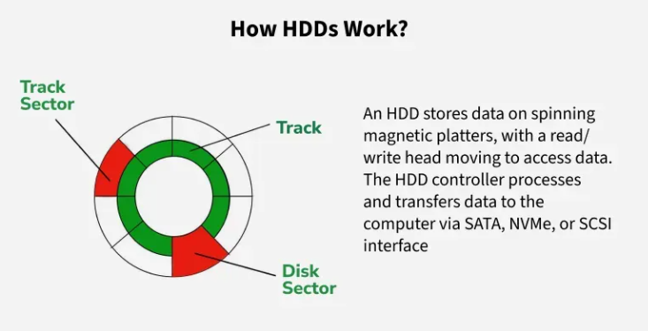
Some space in each sector is used for formatting, so the actual storage available is slightly less than the total capacity.
The R-W head moves over the rotating disk to read and write data.
To access a specific memory location, the head must be positioned correctly, which affects the speed of data retrieval.

Slide 32
External HDDs
External hard drives can be used as a portable data backup device or to increase a computer's storage capacity.
Through connectors like USB 2.0, USB-C or External SATA (eSATA), external disks can be connected to a computer or other device.
Additionally, compared to internal HDDs, external hard drives may transport data more slowly.
In addition to being able to increase a system storage capacity, an external hard drive also has the benefit of being portable.
Users are able to physically carry their stored data on numerous devices with them wherever they go.

Slide 33
Features of HDD
Non-Volatile: Data remains stored even when the power is off, making it ideal for long-term storage.
High Capacity: Can store large amounts of data, with modern HDDs reaching terabytes in size.
Relatively Slow: Slower than RAM, with access times in milliseconds, making it better for storage than frequent data access.
Mechanical Parts: Contains spinning disks and moving read/write heads, which can wear out or get damaged.
Cost-Effective: Cheaper than SSDs, especially for high-capacity storage.
Reliable: Despite mechanical parts, HDDs are durable and widely used for enterprise storage.

Slide 34
RAID (Redundant Arrays of Independent Disks)
RAID is a technique that combines multiple hard drives or SSDs into a single system to improve performance, data safety or both. If one drive fails, data can still be recovered from the others.
In RAID (Redundant Array of Independent Disks), data is not stored on just one hard drive but is distributed across multiple drives.
The data is split into small blocks (like dividing a file into chunks). These blocks are written across multiple drives in parallel.

Slide 35
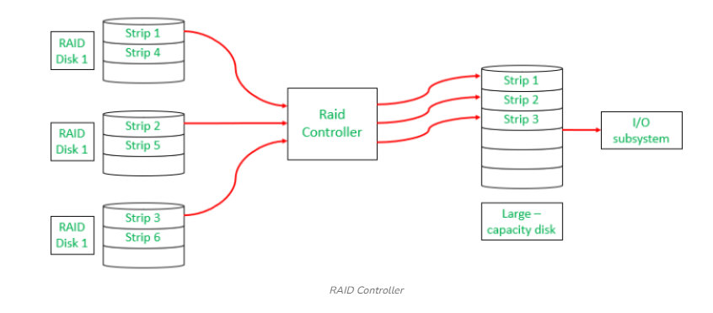
What is a RAID Controller?
A RAID controller manages multiple hard drives, making them work together as one system. It helps improve speed and adds data protection by handling drive failures. Think of it as a smart manager that boosts performance and keeps your data safe.

Slide 36
Why Data Redundancy?
Data redundancy, although taking up extra space, adds to disk reliability. This means,
That in case of disk failure, if the same data is also backed up onto another disk, we can retrieve the data and go on with the operation.
On the other hand, if the data is spread across multiple disks without the RAID technique, the loss of a single disk can affect the entire data.

Slide 37
Different RAID Levels
RAID-0 (Stripping)
RAID-1 (Mirroring)
RAID-2 (Bit-Level Stripping with Dedicated Parity)
RAID-3 (Byte-Level Stripping with Dedicated Parity)
RAID-4 (Block-Level Stripping with Dedicated Parity)
RAID-5 (Block-Level Stripping with Distributed Parity)
RAID-6 (Block-Level Stripping with two Parity Bits)

Slide 38
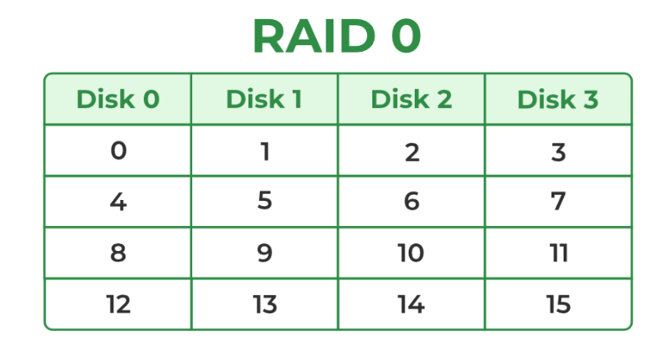
1. RAID-0 (Stripping)
RAID-0 improves system performance by splitting data into smaller "blocks" and spreading them across multiple disks. This process is called "striping." It enhances data access speed by enabling parallel read/write operations but provides no redundancy or fault tolerance.
A set of blocks distributed across the disks forms a "stripe." For instance, "0, 1, 2, 3" is one stripe.
Instead of placing just one block into a disk at a time, we can work with two (or more) blocks placed into a disk before moving on to the next one.

Slide 39
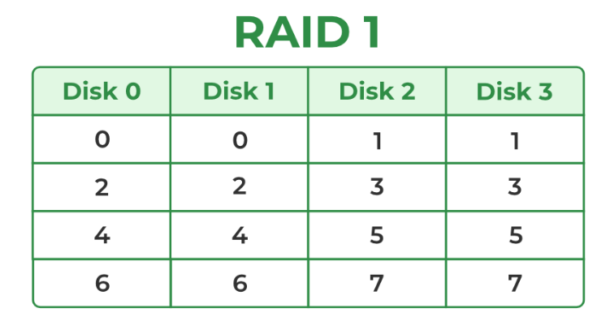
2. RAID-1 (Mirroring)
RAID-1 enhances reliability by creating an identical copy (mirror) of each data block on separate disks. This ensures that even if one disk fails, the data remains accessible from its duplicate. While this configuration is highly reliable, it requires significant storage overhead.
Mirroring: Each block of data is written to two (or more) disks. For example:
Block 0 is stored on Disk 0 and its duplicate on Disk 1.
Block 1 is stored on Disk 2 and its duplicate on Disk 3.
Mirroring Level 2: In the figure, "mirroring level 2" indicates that there are two copies of each block, distributed across different disks. RAID 0 was unable to tolerate any disk failure. But RAID 1 is capable of reliability.

Slide 40
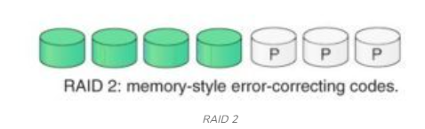
RAID-2 (Bit-Level Stripping with Dedicated Parity)
RAID-2 is a specialized RAID level that uses bit-level striping combined with error correction using Hamming Code.
In this configuration, data is distributed at the bit level across multiple drives and a dedicated parity drive is used for error detection and correction.
While it offers strong fault tolerance, its complexity and cost make it rarely used in practice.

Slide 41
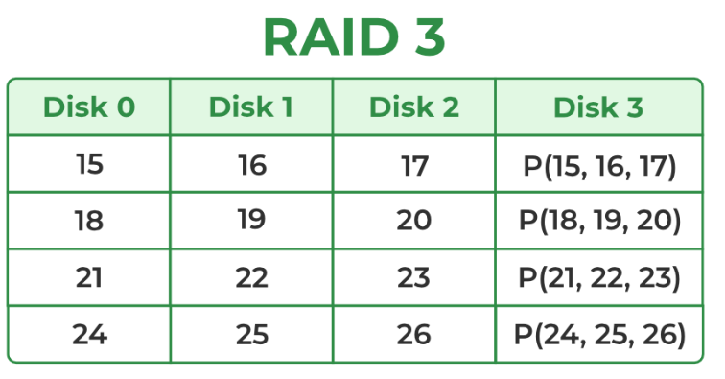
RAID-3 (Byte-Level Stripping with Dedicated Parity)
RAID-3 enhances fault tolerance by employing byte-level striping across multiple drives and storing parity information on a dedicated parity drive.
The dedicated parity drive allows for the reconstruction of lost data if a single drive fails.
This configuration is suitable for workloads requiring high throughput for sequential data but is less efficient for random I/O operations.
Here Disk 3 contains the Parity bits for Disk 0, Disk 1 and Disk 2. If data loss occurs, we can construct it with Disk 3.

Slide 42
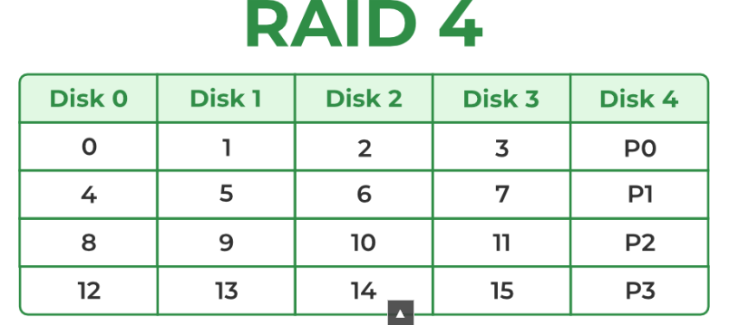
RAID-4 (Block-Level Stripping with Dedicated Parity)
RAID-4 introduces block-level striping across multiple disks, combined with a dedicated parity disk to provide fault tolerance.
Data is written in blocks and a separate disk stores parity information calculated using the XOR function.
This setup allows for data recovery in case of a single disk failure, making RAID-4 more reliable than RAID-0 but less efficient in write-intensive scenarios due to reliance on a dedicated parity disk.
In the figure, we can observe one column (disk) dedicated to parity.
Parity is calculated using a simple XOR function. If the data bits are 0,0,0,1 the parity bit is XOR(0,0,0,1) = 1. If the data bits are 0,1,1,0 the parity bit is XOR(0,1,1,0) = 0.
A simple approach is that an even number of ones results in parity 0 and an odd number of ones results in parity 1.

Slide 43
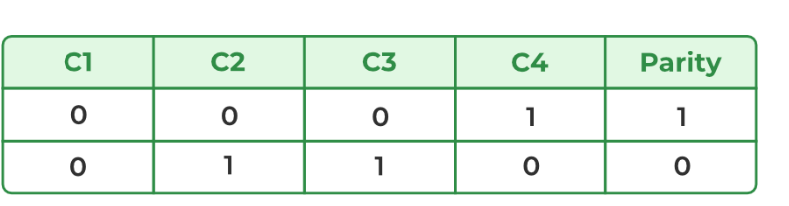
Assume that in the above figure, C3 is lost due to some disk failure.
Then, we can recompute the data bit stored in C3 by looking at the values of all the other columns and the parity bit.
This allows us to recover lost data.

Slide 44
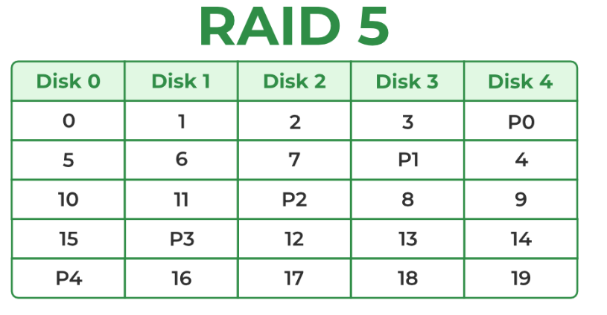
RAID-5 (Block-Level Stripping with Distributed Parity)
RAID-5 builds on RAID-4 by distributing parity information across all disks instead of storing it on a dedicated parity drive. This distributed parity significantly improves write performance, especially for random write operations, while maintaining fault tolerance for single disk failures. RAID-5 is one of the most commonly used RAID configurations due to its balance between reliability, performance and storage efficiency

Slide 45
Block-Level Striping: Data is divided into blocks and striped across all drives in the array.
Distributed Parity: Parity bits, calculated using the XOR function, are distributed across all drives in a rotating pattern.
Example:
Disk 0: Data (D1, D2), Parity (P1)
Disk 1: Data (D3, D4), Parity (P2)
Disk 2: Data (D5, D6), Parity (P3)
Data Recovery: In case of a single disk failure, the missing data can be reconstructed by XOR-ing the remaining data blocks and parity information

Slide 46
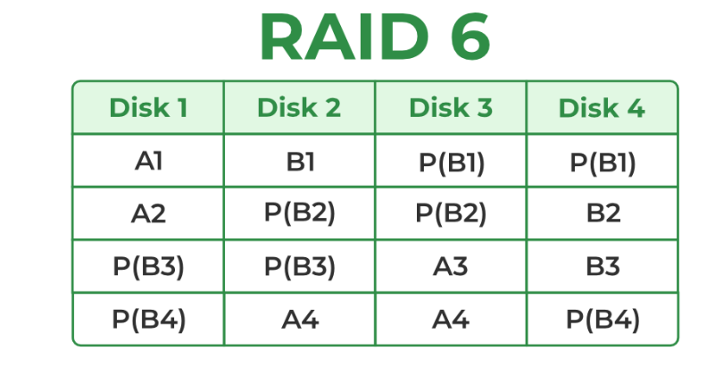
RAID-6 (Block-Level Stripping with two Parity Bits)
RAID-6 is an advanced version of RAID-5 that provides enhanced fault tolerance by introducing double distributed parity.
This allows RAID-6 to recover from the failure of up to two disks simultaneously, making it more reliable for critical systems with larger arrays.
However, the added parity calculations can impact write performance.
Block-Level Striping: Data is divided into blocks and striped across all disks in the array.
Double Distributed Parity: Two sets of parity information are calculated for every block and distributed across all disks in the array in a rotating pattern.

Slide 47
Example:
Disk 0: Data (D1, D2), Parity (P1)
Disk 1: Data (D3, D4), Parity (P2)
Disk 2: Data (D5, P1), Parity (P3)
Disk 3: Parity (P2, P3), Data (D6)
Data Recovery: If one or two disks fail, the missing data can be reconstructed using the remaining data and parity information.

Slide 48
Comparative Table of RAID Levels 0 to 6
RAID Level | Technique | Min Disks | Fault Tolerance | Performance | Storage Efficiency
0 | Striping | 2 | None | ⭐⭐⭐⭐ Very High (R/W) | 100%
1 | Mirroring | 2 | 1 Disk | ⭐⭐⭐ Read / ⭐⭐ Write | 50%
2 | Hamming-code ECC | 3+ | 1+ (ECC) | ⭐⭐ Moderate | Low
3 | Byte Striping + Dedicated Parity | 3 | 1 Disk | ⭐⭐⭐ Read / ⭐ Low Write | (N–1)/N
4 | Block Striping + Dedicated Parity | 3 | 1 Disk | ⭐⭐⭐ Read / ⭐ Low Write | (N–1)/N
5 | Block Striping + Distributed Parity | 3 | 1 Disk | ⭐⭐⭐ Read / ⭐⭐ Write | (N–1)/N
6 | Block Striping + Dual Parity | 4 | 2 Disks | ⭐⭐⭐⭐ High / ⭐⭐ Write | (N–2)/N

